Slide 1
Real-Time Vehicle Detection in Traffic Monitoring using YOLO model
Nguyen, James

Slide 2
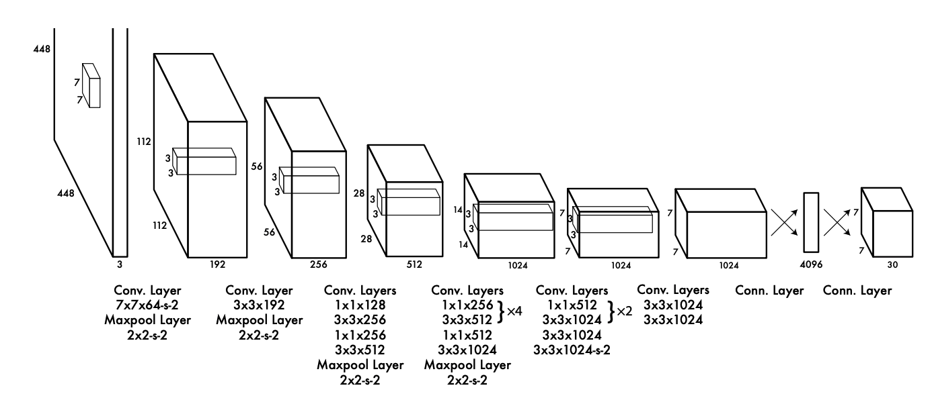
What is YOLO?
Real-time object detection algorithm
Single NN prediction:
Bounding boxes
Classifies probabilities
24 convolutional layers, 4 max-pooling layers, 2 fully connected layers
Notes:
YOLO treats object detection as a regression problem — predicting bounding boxes and class probabilities directly from full images in one evaluation
Called a state of art because of its revolutionized object detection by introducing a fast, accurate, and efficient single-pass detection system
How it works:
Resizes the input image into 448x448 before going through the convolutional network.
before this 3x3 convolution, there is a 1x1 convolution applied to reduce the number of channels, to generate a cuboidal output
The activation function is ReLU (max(0, x)), except for the last layer, which uses a linear activation function.
Some additional techniques, such as batch normalization and dropout, regularize the model and prevent it from overfitting.

Slide 3
YOLO vs Other models
(Real-time) detectors | mAP
R-CNN | 53.5
Faster R-CNN | 70
SSD | 50.7
YOLO | 63.4
Notes:
SSD - Single Shot Detectors
mAP - mean average precision
The accuracy of these model are not that big different, sometimes, other models can pass the accuracy of YOLO model
These results are already taken FPS into account

Slide 4
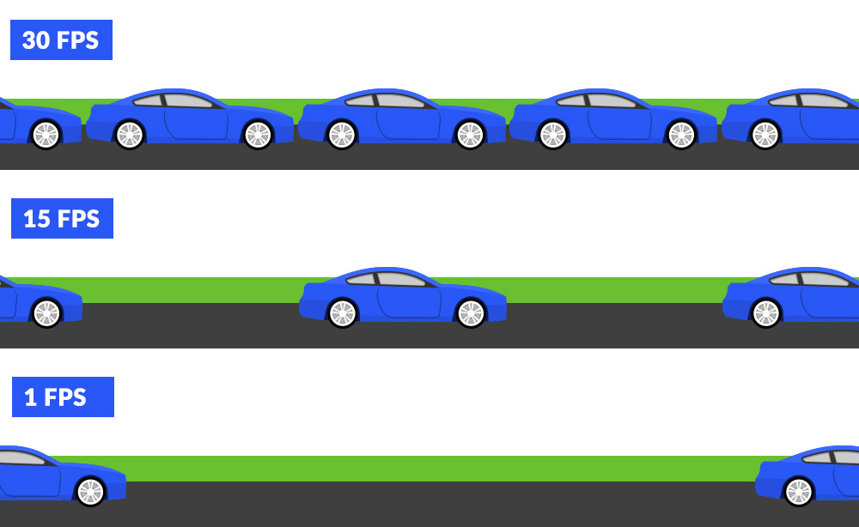
Why YOLO?
High FPS with good accuracy
Strong localization functionality
Real-time detectors | mAP | FPS
R-CNN | 53.5 | 6
Faster R-CNN | 70 | 5-17
SSD | 50.7 | 23-59
YOLO | 63.4 | 40-155
Notes:
The accuracy of YOLO also can be increased by combining with other classifiers
The mAP SSD is for a specific dataset only, but for some dataset, it can archive much higher (slightly higher than YOLO), with FPS upto 46
SSD may lag in crowded scenes, faster R-CNN not Real-Time Suitability due to its two-stage architecture (sometimes FPS can be as low as 0.5)
FPS (frames per second) measures how quickly a model can process images,. YOLO models are designed to prioritize high FPS, making them more suitable for real-time applications compared to models like Faster R-CNN that are slower but may achieve slightly higher accuracy. In real-world scenarios, faster detection is often more important than minor accuracy gains.

Slide 5
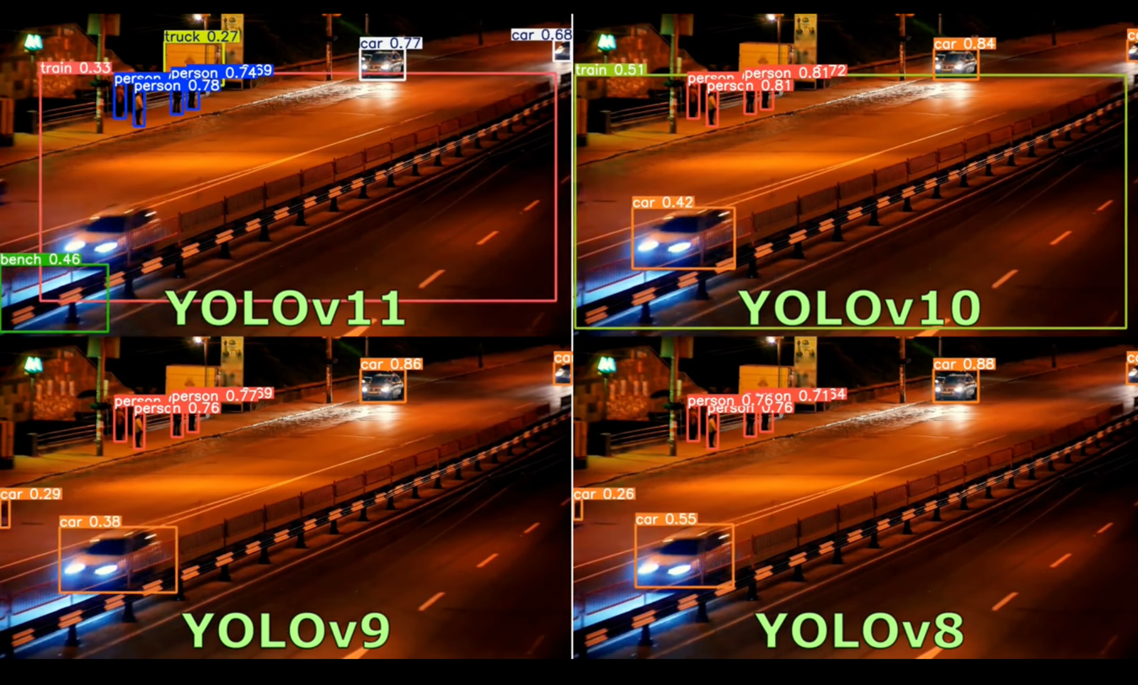
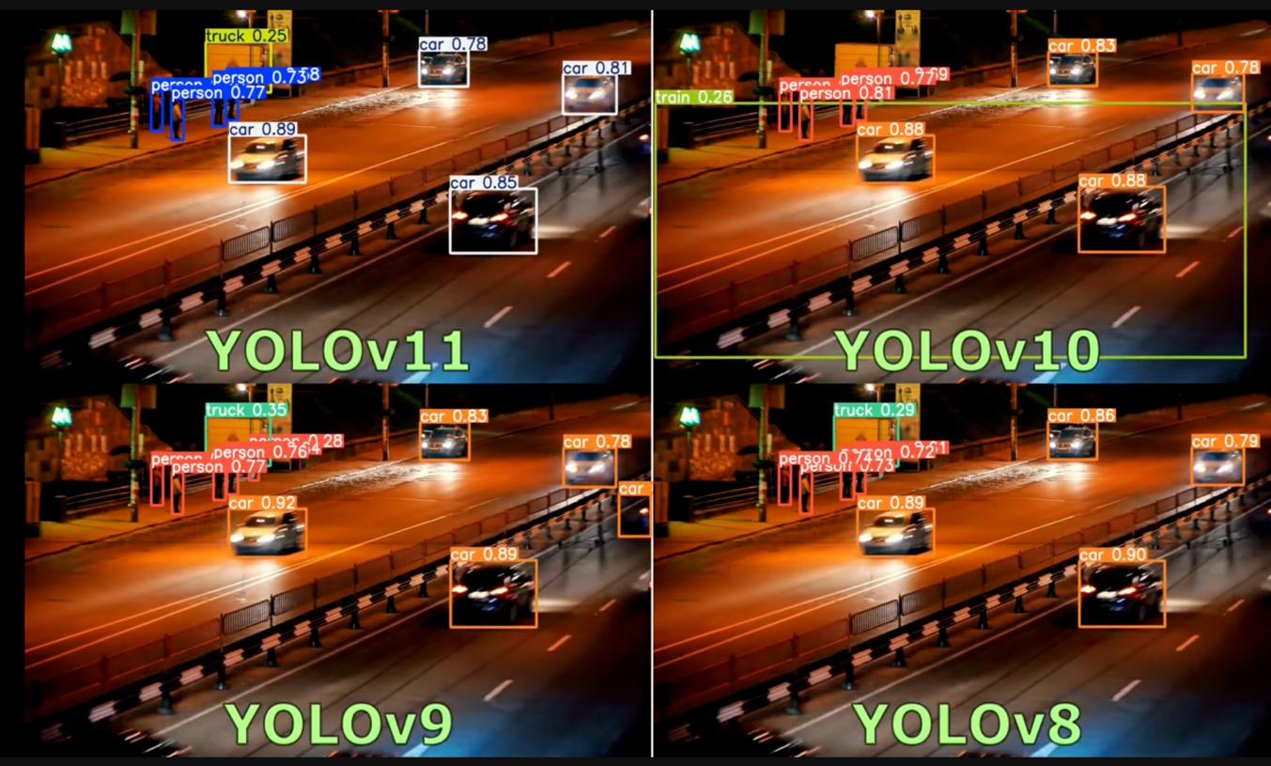
Why YOLOv8?

Slide 6
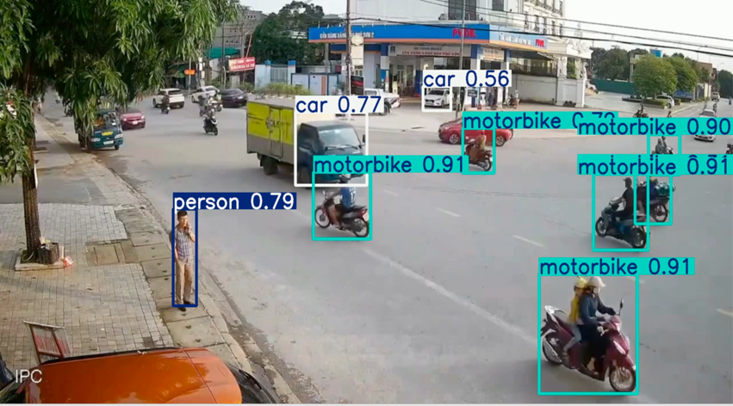
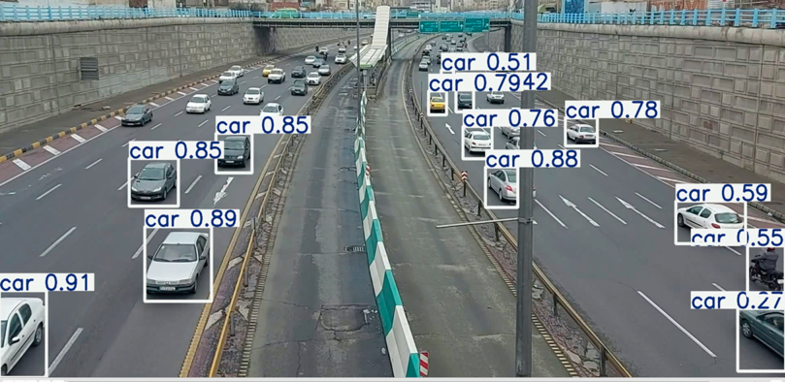
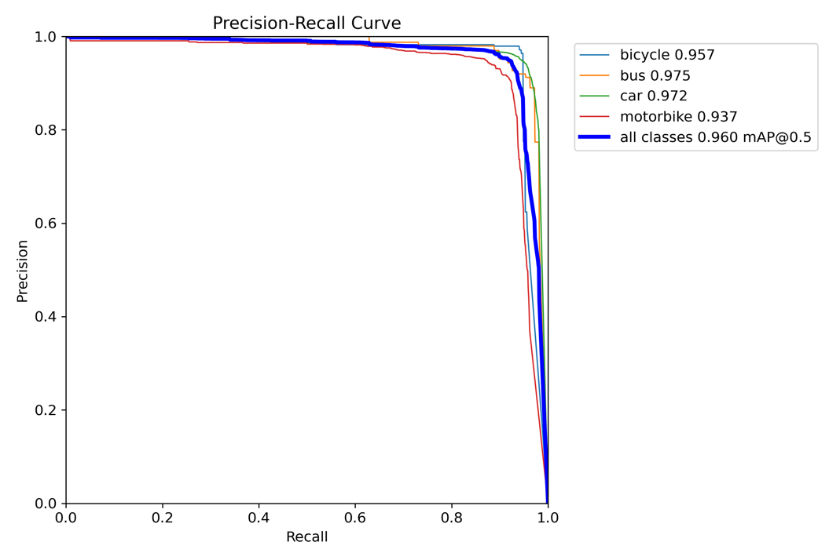
Result
 | bicycle | bus | car | motorcycle | person
Precision | 0.96822 | 0.91911 | 0.94042 | 0.9386 | 0.9248
Recall | 0.944 | 0.94683 | 0.95497 | 0.889 | 0.89663

Slide 7
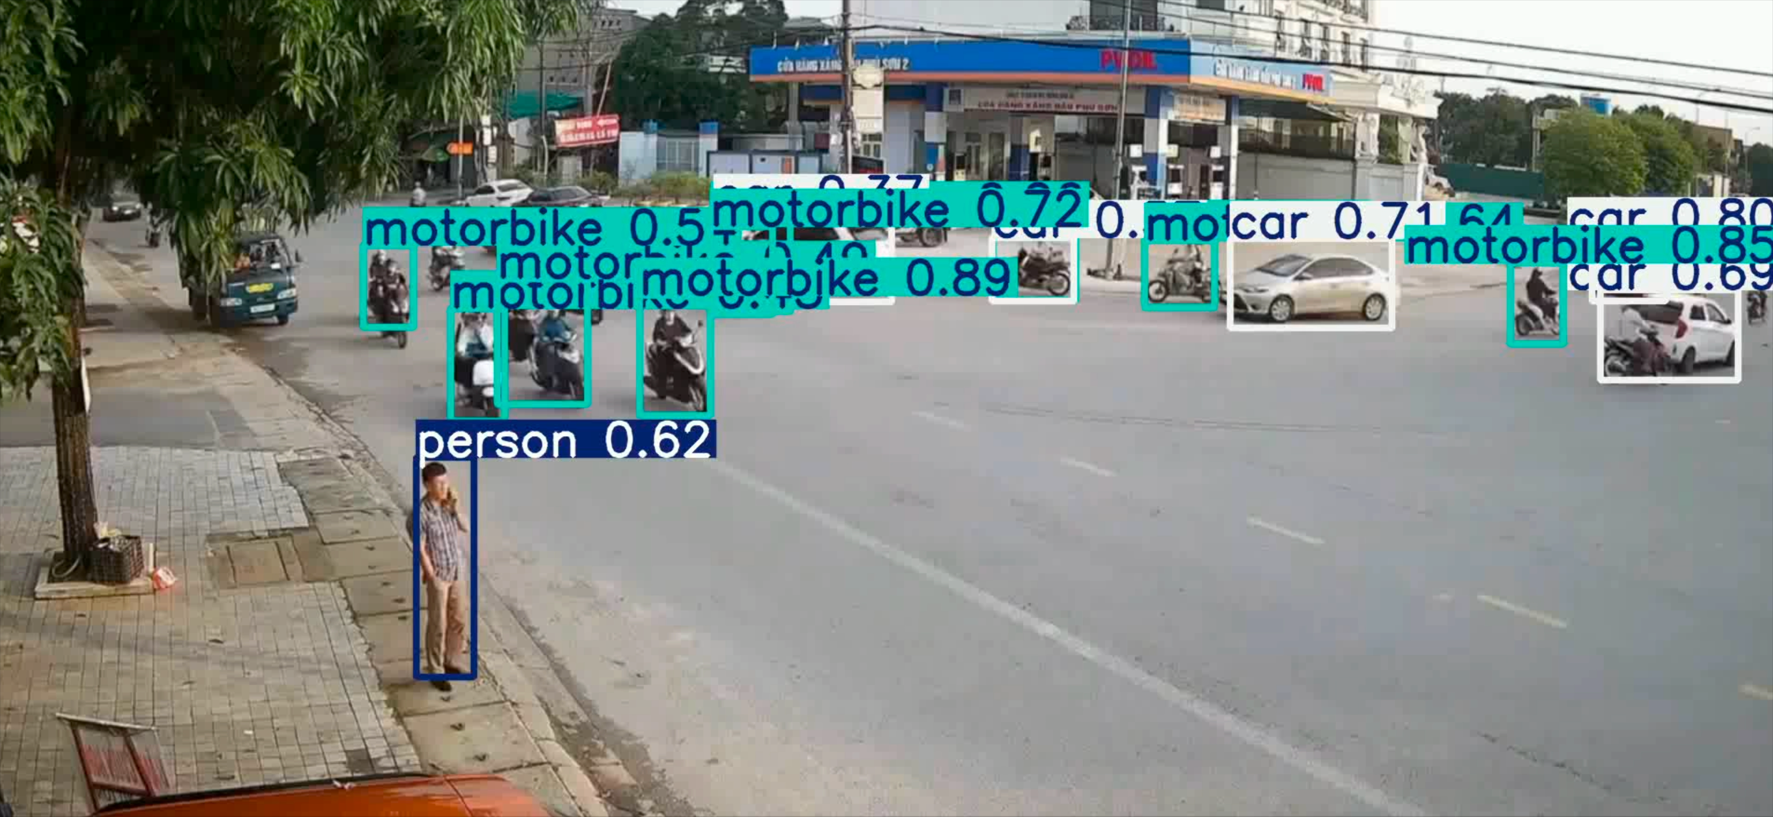

Slide 8
Thank you for listening

